Slide 1
COMPUTER SCIENCE MATH
Heart Disease

Slide 2


OUR MEMBERS
HOÀNG MINH HIẾU
HOÀNG NGUYÊN THÁI

Slide 3
OUR MEMBERS
TRƯƠNG VĂN KHẢI
NGÔ CAO LỘC

Slide 4
TABLE OF CONTENTS
01
02
03
CODE
PROBLEM & DATA SOLUTION
PERFORMANCE METRICS
Data True & Data False
Logistic Regression
Confusion Matrix

Slide 5
PROBLEM
0

Slide 6
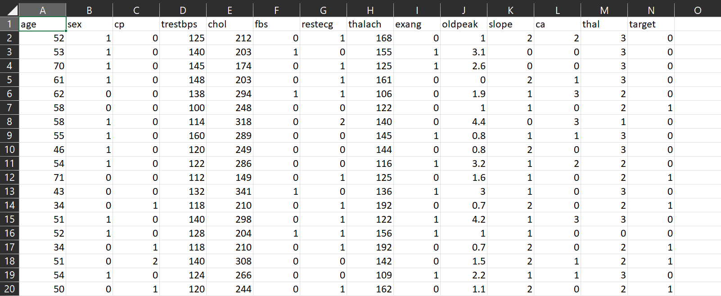
HEART DISEASE

Slide 7
CASE STUDY
1

Slide 8
TARGET
DATA
(Split) Data True
368
70% (train)
158
30% (test)
(Split) Data False
526
True
349
70% (train)
499
False
150
30% (test)

Slide 10
INDEX
0.87897
0.87341
Accuracy
Recall
138 | 17
20 | 133
Confusion Matrix
Precision
F1
0.89032
0.88178

Slide 11
CASE STUDY
2

Slide 12
TARGET
DATA
(Split) Data True
100
19% (train)
426
81% (test)
(Split) Data False
526
True
349
70% (train)
499
False
150
30% (test)

Slide 13
CODE

Slide 14
INDEX
0.8125
0.75821
Accuracy
Recall
323 | 5
103 | 145
Confusion Matrix
Precision
F1
0.98475
0.85676

Slide 15
CASE STUDY
3

Slide 16
TARGET
DATA
(Split) Data True
100
19% (train)
426
81% (test)
(Split) Data False
526
True
349
70% (train)
499
False
150
30% (test)

Slide 17
CODE

Slide 18
INDEX
0.8125
0.75821
Accuracy
Recall
323 | 5
103 | 145
Confusion Matrix
Precision
F1
0.98475
0.85676

Slide 19
CASE STUDY
4

Slide 20
TARGET
DATA
(Split) Data True
100
19% (train)
426
81% (test)
(Split) Data False
526
True
349
70% (train)
499
False
150
30% (test)

Slide 21
CODE

Slide 22
INDEX
0.8125
0.75821
Accuracy
Recall
323 | 5
103 | 145
Confusion Matrix
Precision
F1
0.98475
0.85676

Slide 23
CASE STUDY
5

Slide 24
TARGET
DATA
(Split) Data True
100
19% (train)
426
81% (test)
(Split) Data False
526
True
349
70% (train)
499
False
150
30% (test)

Slide 25
CODE

Slide 26
INDEX
0.8125
0.75821
Accuracy
Recall
323 | 5
103 | 145
Confusion Matrix
Precision
F1
0.98475
0.85676

Slide 27
CONSUMPTION
6

Slide 29
THANKS
Do you have any questions?

